Slide 1
Spark Structured streaming
2024
The Hoang

Slide 2
Learning Objectives
Understanding Structured Streaming and Kafka Basics
Advanced Topics and Optimization
Stateful processing and event-time aggregation
Watermarking and late event handling
Spark and Kafka Integration Overview
Real-World Applications

Slide 3
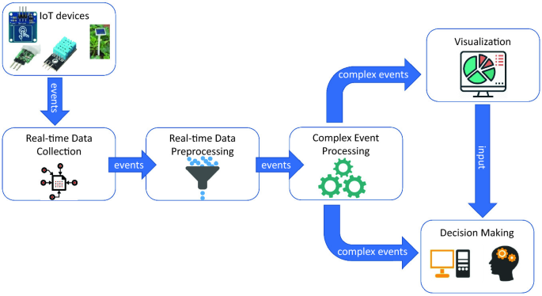
RECAP
Data processing – What is Stream Processing?
Definition
Stream processing involves processing data in real-time as it arrives, enabling low-latency processing.
Characteristics
Continuous input and processing of data.
Unbounded, they have no predefined end.
Suitable for real-time analytics and monitoring.
Lower latency but can be more complex to implement.
Example
Using Apache Kafka and Apache Flink for real-time fraud detection in financial transactions.

Slide 4
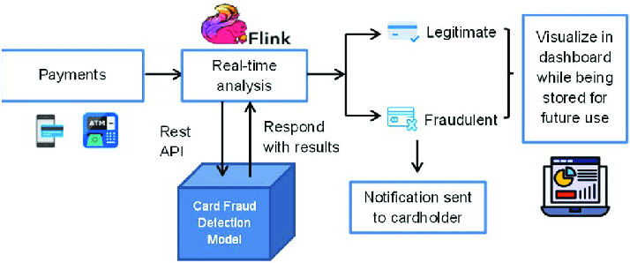
RECAP
Data processing – Stream processing example
Scenario
Real-time monitoring of credit card transactions to detect fraud.
Steps
Data Ingestion: Transactions are ingested from Kafka in real-time.
Stream Processing: Apache Flink processes each transaction to identify anomalies.
Anomaly Detection: Suspicious transactions are flagged immediately.
Output: Real-time alerts are sent to the fraud detection team.
Advantages
Immediate detection and response to fraud.
Disadvantages
More complex to manage and scale.

Slide 5
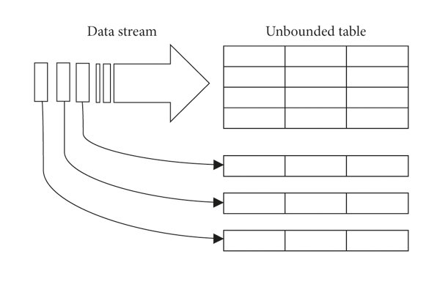
Spark Structured streaming - introduction
Structured Streaming is a scalable and fault-tolerant stream processing engine built on the Spark SQL engine.
It allows you to express streaming computations in the same way you would express batch computations on static data.
The Spark SQL engine manages the execution of these computations incrementally and continuously, updating the results as new data arrives.
This approach provides end-to-end exactly-once fault-tolerance guarantees through mechanisms like checkpointing and Write-Ahead Logs.
Structured Streaming treats a live data stream as a continuously appended table, enabling users to perform operations like aggregations and event-time windows seamlessly

Slide 6
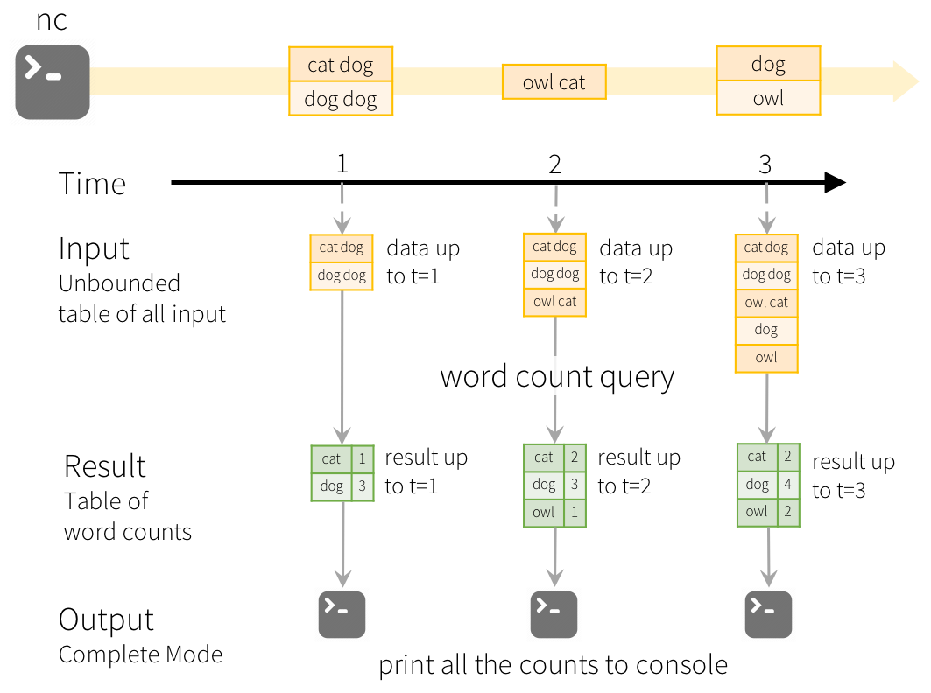
Streaming DataFrames / Datasets in Spark
In Structured Streaming, a streaming DataFrame or Dataset represents a continuously updating table. Each row corresponds to a new data item arriving in the stream.
Operations can be performed on these streaming DataFrames, as filtering, aggregating, and joining with other DataFrames.
The operations are defined in a way that they can be executed incrementally, allowing Spark to process new data as it arrives without needing to reprocess the entire dataset.

Slide 7
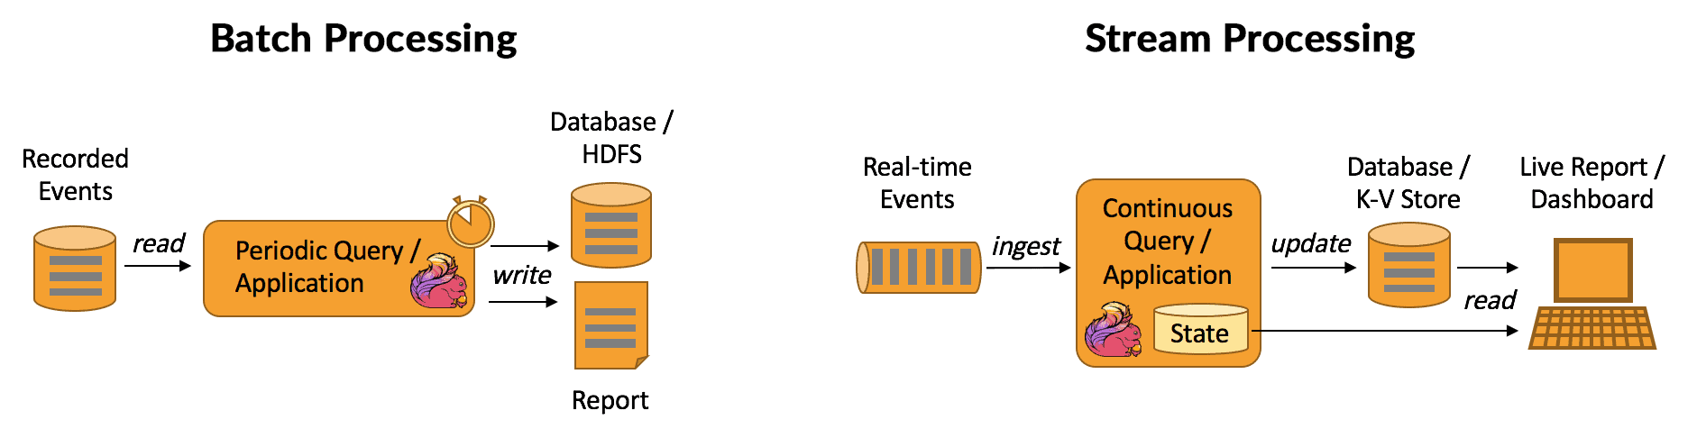
RECAP
Data processing – Batch vs. Stream Processing
Comparison
When to Use
Batch Processing: When processing large volumes of historical data.
Stream Processing: When immediate data processing and response are required.
Feature | Batch Processing | Stream Processing
Data Ingestion | Collected over time | Continuous
Processing Frequency | Scheduled intervals | Real-time
Latency | High | Low
Use Cases | Historical data analysis | Real-time monitoring
Complexity | Simpler | More complex

Slide 8
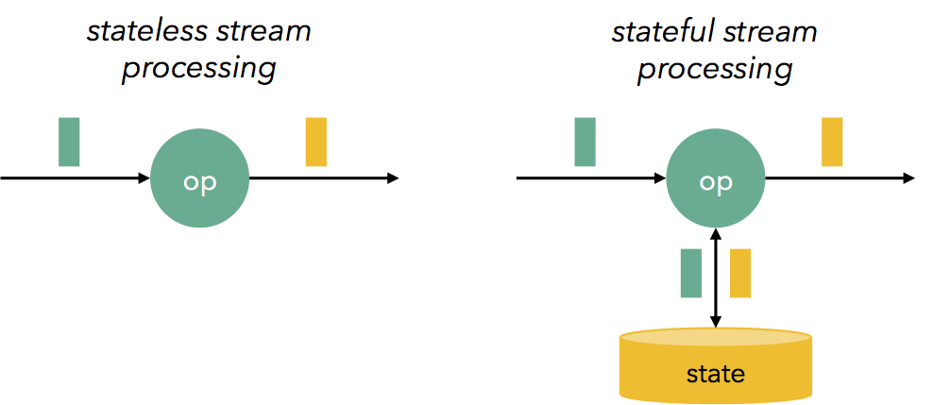
RECAP
Data processing – Deep Dive into Stream Processing
Stateless Processing
Stateless streaming processing is a type of data processing where the system does not maintain any state or memory of past events. Each incoming data item is processed independently, without relying on information from previous items.
Common use cases for stateless streaming processing:
Ingesting, cleaning, and transforming data.
Filtering out unwanted data based on specific criteria.
Applying transformations to data, such as converting data formats or calculating derived values.
Calculating basic aggregations like sums, averages, or counts over a window of data.

Slide 9
RECAP
Data processing – Deep Dive into Stream Processing
Stateful Processing
Keeping track of state across multiple events.
Key concepts
State: information about past events or calculations
Stateful operators: maintain and update state. E.g.: aggregate, reduce, and window
State store: storage mechanism for state. It can be in-memory, persistent storage (like HDFS or S3), or a combination of both.

Slide 10
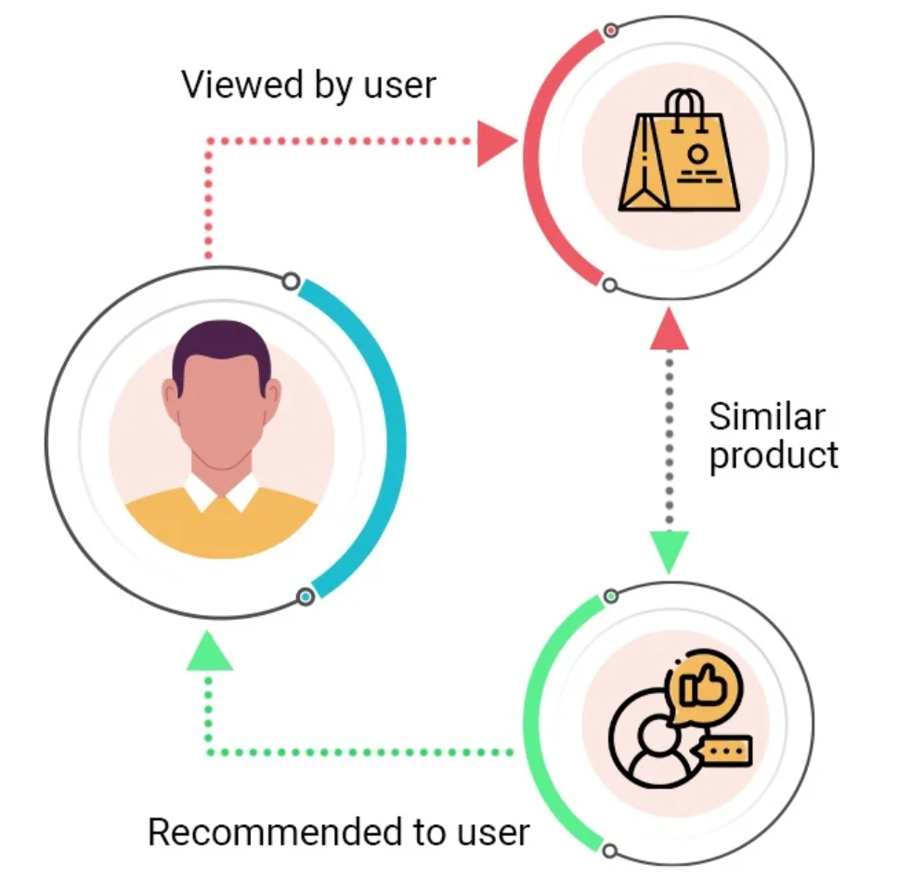
RECAP
Data processing – Deep Dive into Stream Processing
Examples
Stateless:
Filtering financial transactions: Filtering out fraudulent transactions based on real-time rules.
Analyzing IoT sensor data: Detecting anomalies in sensor data to identify equipment failures.
Stateful:
Recommender systems: Providing personalized recommendations based on user behavior and historical data.
Fraud detection: Detecting fraudulent activities by tracking user behavior over time and identifying suspicious patterns.
Inventory management: Tracking inventory levels in real-time and triggering replenishment orders when stock levels fall below a threshold.

Slide 11
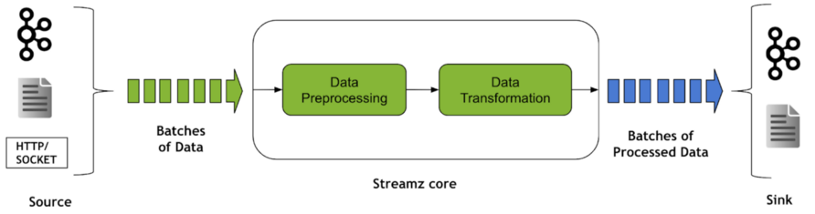
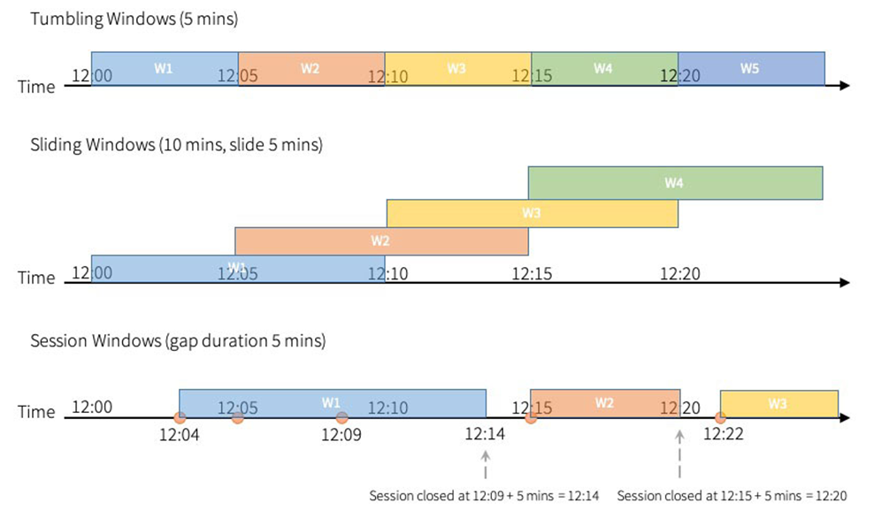
RECAP
Data processing – Deep Dive into Stream Processing
Types of time windows
Windows
Time-based grouping of data streams
Types
Tumbling windows: fixed-sized, non-overlapping, continuous time intervals; An input can only be bound to a single window.
Sliding windows: fixed-sized, can overlap duration of slide is smaller than the duration of window. In this case an input can be bound to the multiple windows
Session windows: dynamic size of the window length, depending on the inputs; starts with an input, and expands itself if following input has been received within gap duration. A session window closes when there’s no input received within gap duration after receiving the latest input.

Slide 12

RECAP
Data processing – Deep Dive into Stream Processing
Handle late events with watermark
Watermarks: a design or pattern embedded in paper during its manufacture.
However, in streaming processing, watermark is mechanism to handle late-arriving data.
Fyi: The term "watermark" is a metaphor drawn from paper and printing. The watermark is a timestamp that's embedded in the stream of data.

Slide 13
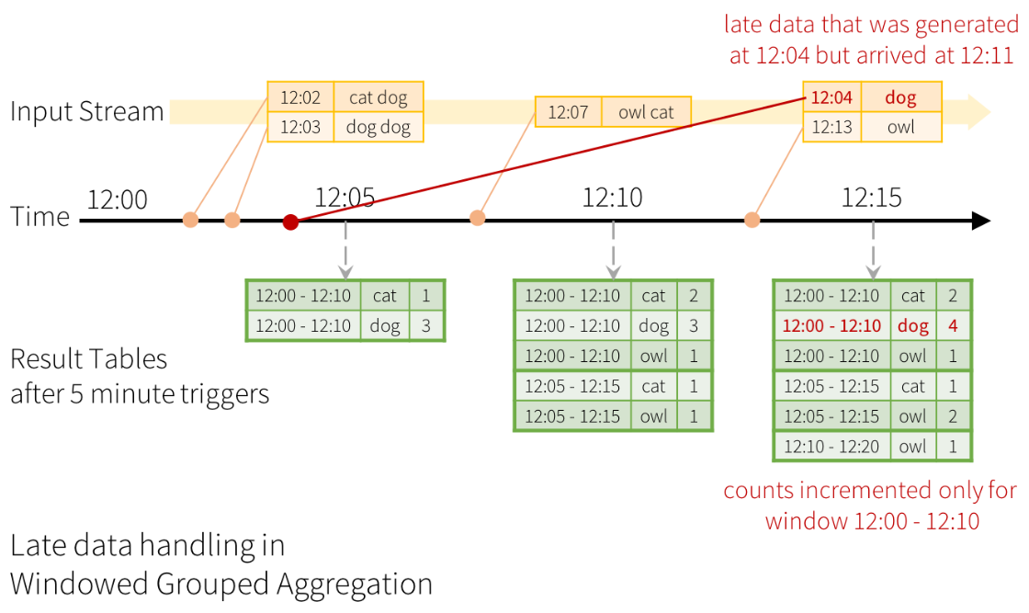
RECAP
Data processing – Deep Dive into Stream Processing
Handle late events with watermark
Watermarks: Mechanism to handle late-arriving data.
Types of timestamps:
Event time: event occurred in the real world
Arrived time / ingestion time
Processing time
Watermark timestamp: indicates the latest event time that has been processed by the system.
Late events handling:
Buffering: store late events for later processing
Processing with a delay: wait for a period, then process
Dropping

Slide 14
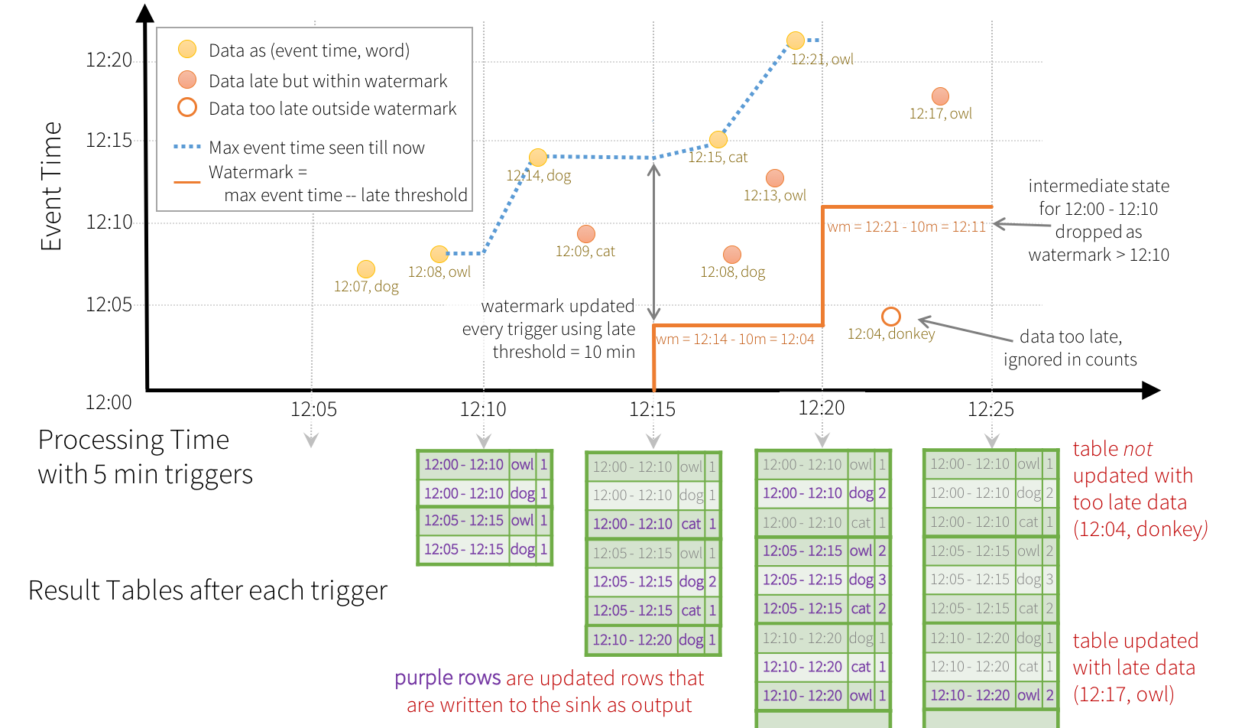
RECAP
Data processing – Deep Dive into Stream Processing

Slide 15
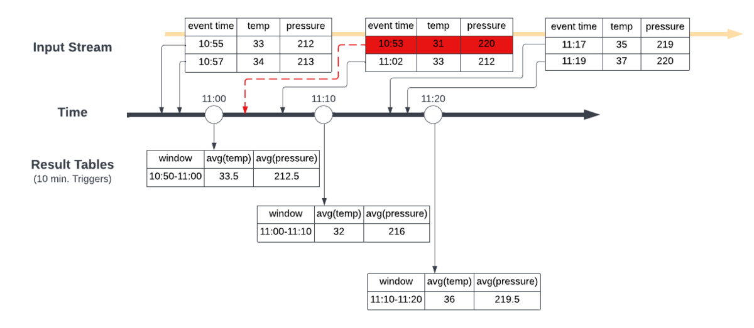
Event-time and Watermarking
Event-time refers to the time at which an event occurs, as opposed to the time it is processed.
In streaming applications, handling event-time is crucial for accurate processing, especially when dealing with out-of-order data.
Watermarking is a technique used to manage late data in streaming applications. It allows you to specify a threshold for how late data can arrive and still be processed.
By using watermarks, you can ensure that your computations remain efficient and that you do not wait indefinitely for late data, thus maintaining the integrity of your results

Slide 16
Event-time and Watermarking

Slide 17
RECAP
Data processing – Deep Dive into Stream Processing
Output modes
Append
This mode appends new rows to the existing output data.
It's suitable for use cases where you want to accumulate data over time.
Complete
This mode overwrites the entire output dataset with each new batch of data.
It's useful when you want to get the latest state of the data.
Update
This mode updates existing rows based on a key and updates the output dataset.
It's suitable for use cases where you want to modify existing data based on new information.
1
2
3
4
1
2
3
4
1
2
3’
4

Slide 18
NEW
Data processing – Deep Dive into Stream Processing
Output Sinks and Supported Output Modes
Format | Append | Complete | Update
Delta | Yes | Yes | Yes
Parquet | Yes | No | No
JSON | Yes | No | No
CSV | Yes | No | No
ORC | Yes | No | No
Text | Yes | No | No
Kafka | Yes | Yes | Yes
Console | Yes | Yes | Yes
Memory | Yes | Yes | Yes

Slide 19
Differences between Structured Streaming, DStreams, and batch processing
Criteria | Structured Streaming | Dstreams (Discretized Streams) | Batch Processing
Data Processing Model | Continuous processing of streaming data as a table. | Micro-batch processing of data streams. | Processing of static datasets in batches.
API | Uses DataFrame and Dataset APIs for both batch and streaming. | Based on RDDs (Resilient Distributed Datasets). | Primarily uses RDDs or DataFrames for batch jobs.
Latency | Low latency with options for continuous processing. | Higher latency due to micro-batch intervals. | High latency; results are available after batch completion.
Fault Tolerance | Provides exactly-once processing guarantees. | Offers at-least-once processing guarantees. | Typically allows for reprocessing of failed batches.

Slide 20
Differences between Structured Streaming, DStreams, and batch processing
Criteria | Structured Streaming | Dstreams (Discretized Streams) | Batch Processing
Complexity | More complex due to continuous data flow and state management. | Simpler than Structured Streaming but less flexible. | Generally simpler as it deals with finite data chunks.
Scalability | Highly scalable, designed for both high throughput and low latency. | Scalable but less efficient for high-velocity data. | Scalable for large volumes but may require more resources for batch jobs.
Use Cases | Real-time analytics, monitoring, and event-driven applications. | Streaming data processing for applications like log analysis. | ETL processes, reporting, and large-scale data analysis.
Event Time Handling | Supports event-time processing and watermarking for late data. | Limited support for event-time; primarily processes based on arrival time. | Does not handle event-time; processes data as it arrives in batches.

Slide 21
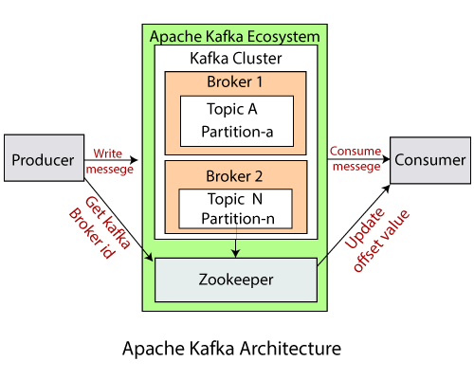
Apache kafka – architecture & core concepts
A topic is a category or feed name to which records are published. Topics are partitioned for scalability.
Producers are applications that publish messages to Kafka topics. They can choose which partition to send messages to.
Consumers read messages from topics. They can be part of a consumer group, allowing for load balancing and fault tolerance.
A consumer group consists of one or more consumers that work together to consume topics. Each message is delivered to one consumer within the group.
Each topic can be divided into partitions, which are ordered and immutable sequences of messages. Partitions allow for parallel processing.

Slide 22
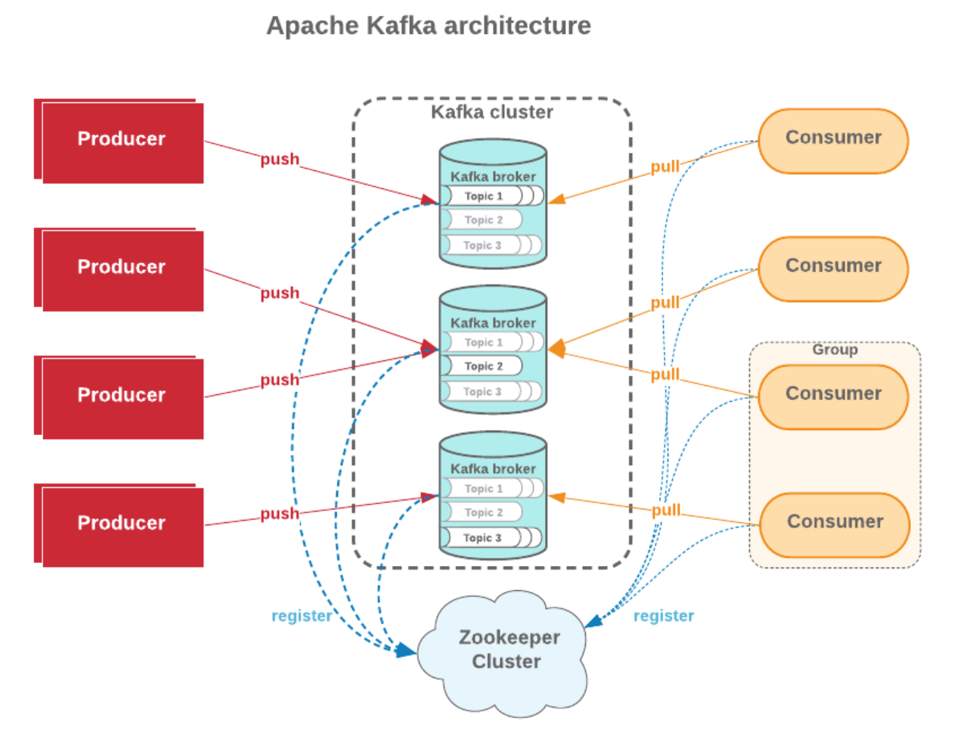
Apache kafka – architecture & core concepts
Each message within a partition has a unique offset that denotes its position. Consumers track offsets to know which messages have been processed.
Kafka runs in a cluster of servers, known as brokers. Each broker is responsible for storing and serving partitions of topics.
Replication: Kafka replicates partitions across multiple brokers to ensure fault tolerance. Each partition has a leader and multiple followers.
Zookeeper is used for cluster coordination, maintaining metadata about the Kafka cluster, and managing broker configurations.
Kafka Connect: A tool for connecting Kafka with external systems, such as databases and file systems.

Slide 23
Apache kafka – spark integration

Slide 24
Lab practice

